Slide 1
An Intelligent Tesla Autopilot Car Drive By Using AI

Slide 2
Abstract :
Tesla Autopilot is what’s known as an autonomous driver assistance system. In simple terms it’s a feature that allows a Tesla to ‘see’ the cars and road around it, and drive itself to a limited degree. Tesla's software works with a number of cameras to analyze road conditions in real-tim
self-driving algorithms have drawn growing research efforts from both industry and academia using low-cost vehicle-mounted cameras. In a self-driving car, various automation levels have been described. At level 0, there is no automation. The car is controlled by a human driver. Level 1 and Level 2 are specialized driver assistance systems where the system is still controlled by a human driver, but a few functions are automated, such as brake, stability control, etc. Level 3 vehicles are autonomous although it requires a human driver to intervene and monitor. Level 4 vehicles are completely autonomous, but the automation is restricted to the vehicle’s operating architecture environment i.e. not all driving situations are covered, Level 5 vehicles are assumed to be fully autonomous and their efficiency should be equal to that of a human driver. In the near future, we are still far from reaching level 5 self-driving vehicles.
There is a rise in curiosity about self-driving vehicles. This is because of breakthroughs in deep learning, where deep neural networks are learned to perform tasks that usually need human intervention. To recognize patterns and characteristics in images, CNN applies models, making them helpful in the field of computer vision. Some of the examples of these are image classification, object detection, object detection, etc.

Slide 3
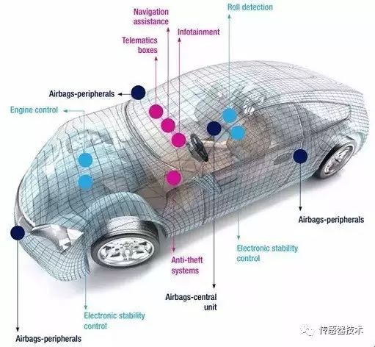
Existing System
Autopilot introduces new features and improves existing functionality to make your Tesla safer and more capable over time.
Autopilot enables your car to steer, accelerate and brake automatically within its lane.
Current Autopilot features require active driver supervision and do not make the vehicle autonomous.

Slide 4
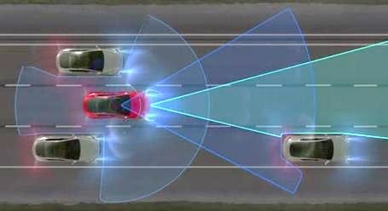
Proposed System
Tesla Autopilot is what's known as an autonomous driver assistance system.
In simple terms it's a feature that allows a Tesla to 'see' the cars and road around it, and drive itself to a limited degree.
This doesn't mean Autopilot is capable of turning a Tesla into a fully autonomous self-driving car.

Slide 5
Disadvantages:
Tesla Could Run Out of Batteries.
Electric Vehicle Competition.
Tesla Cars Are Too Expensive.

Slide 6
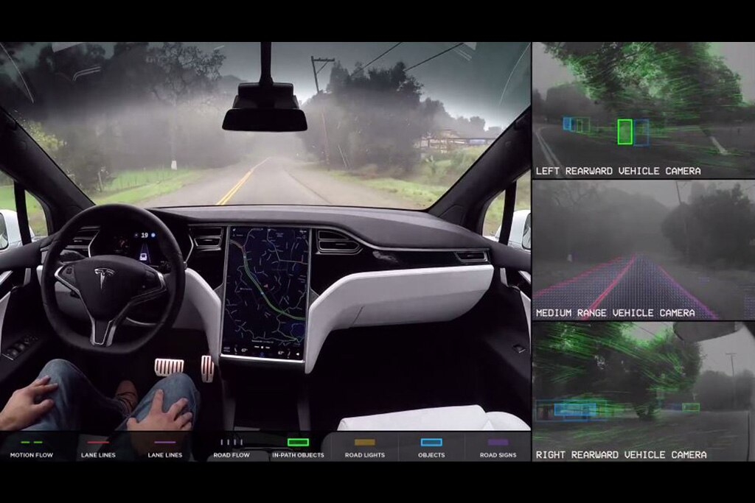
Advantages
Current Autopilot features require active driver supervision and do not make the vehicle autonomous
The reduction in car crash-related costs, reduced strain on the healthcare system, more efficient transportation, better fuel savings, and more can Autopilot introduces new features and improves existing functionality to make your Tesla safer and more capable over time.
Autopilot enables your car to steer, accelerate and brake automatically within its lane.
all contribute to the overall societal cost-savings.
Better Learning Techniques.
Tesla cars come with an impressive battery range. ...

Slide 7
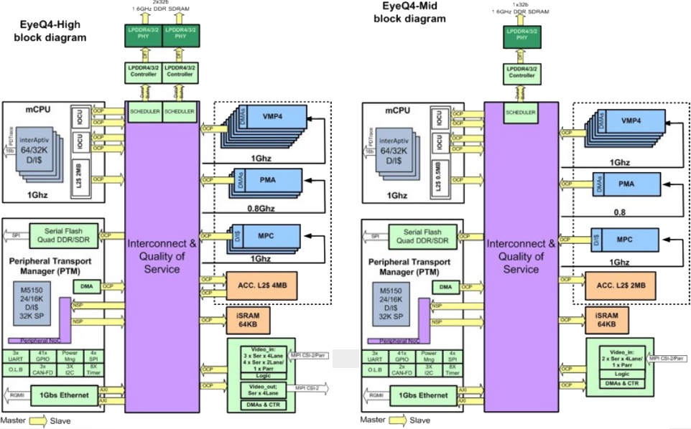
System Architecture

Slide 8
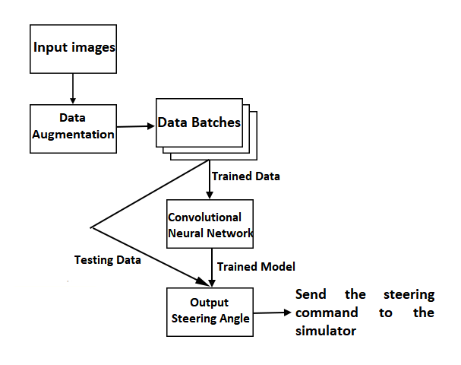

Slide 9
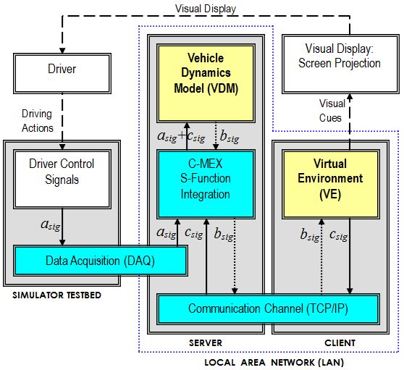
DFD(data flow diagram)Diagram
A data flow diagram (DFD) is a graphical or visual representation using a standardized set of symbols and notations to describe a business's operations through data movement.
They are often elements of a formal methodology such as Structured Systems Analysis and Design Method (SSADM).

Slide 10
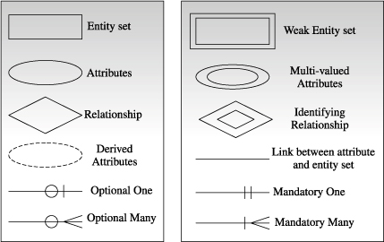
E-R Diagram
An entity relationship diagram (ERD), also known as an entity relationship model, is a graphical representation that depicts relationships among people, objects, places, concepts or events within an information technology (IT) system.
An entity–relationship model describes interrelated things of interest in a specific domain of knowledge. A basic ER model is composed of entity types and specifies relationships that can exist between entities.

Slide 11
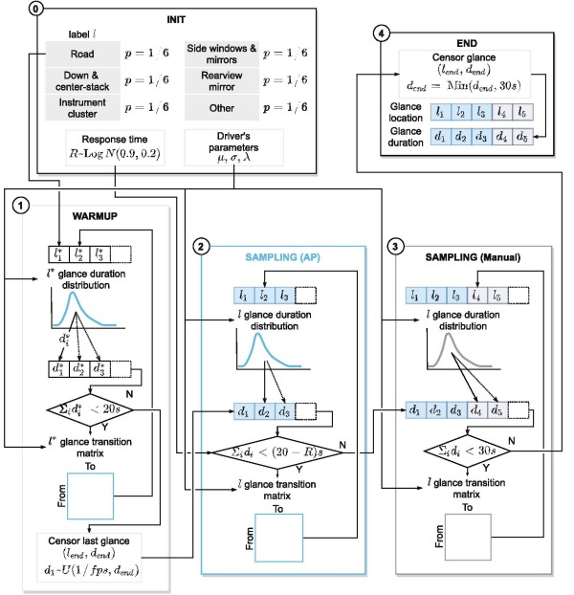

Slide 12
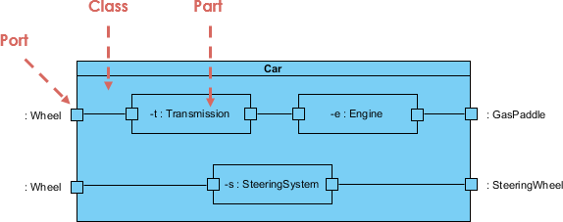
UML( Unified Modeling Language) Diagram
Most commonly, a UML diagram is used to analyze existing software, model new software, and plan software development and prioritization. Simply put, if you need a way to visualize and plan your software development process, a UML diagram is incredibly helpful

Slide 13
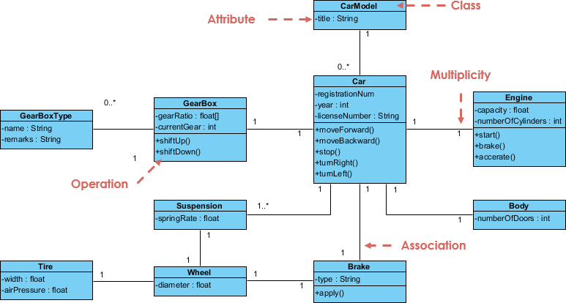

Slide 14
Modules:
Perception
Localization
Prediction
Decision Making

Slide 15
MODULE DESCRIPTION
1.Perception:: One of the most important properties that self-driving cars must have is perception, which helps the car see the world around itself, as well as recognize and classify the things that it sees. In order to make good decisions, the car needs to recognize objects instantly.

Slide 16
2. Localization:: Localization algorithms in self-driving cars calculate the position and orientation of the vehicle as it navigates – a science known as Visual Odometry (VO).

Slide 17
3. Prediction:: Understanding human drivers is a very complex task. It involves emotions rather than logic, and these are all fueled with reactions. It becomes very uncertain what the next action will be of the drivers or pedestrians nearby, so a system that can predict the actions of other road users can be very important for road safety

Slide 18
4.Decision Making :: Decision-making is vital in self-driving cars. They need a system that’s dynamic and precise in an uncertain environment. It needs to take into account that not all sensor readings will be true, and that humans can make unpredictable choices while driving. These things can’t be measured directly. Even if we could measure them, we can’t predict them with good accuracy

Slide 19
System Specification:
Software Requirements:
Operating System: Windows
Coding Language: Python
Hardware Requirements:
Processor – i3
Speed – 2.4 GHz
RAM – 4 GB
Hard Disk - 500 GB

Slide 20
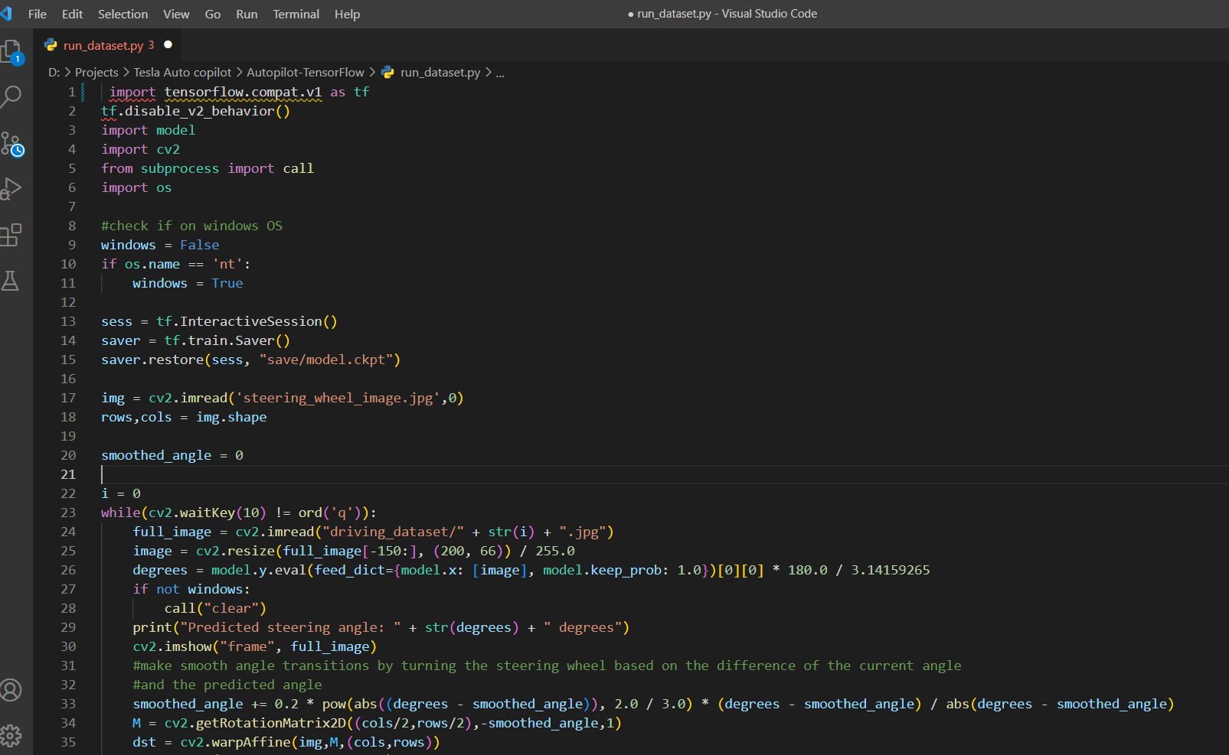
Source Code:

Slide 21
Testing Plan
The purpose of testing is to discover errors. Testing is the process of trying to discover every conceivable fault or weakness in a work product. It provides a way to check the functionality of components, sub assemblies, assemblies and/or a finished product.
Test Strategies:
Unit Testing
Integration Testing
System Testing
Black Box Testing
White Box Testing

Slide 22
Testing Cases
Sno. | Test cases | input | Expected out put | Observe Out put | Result
1 | Upload the video | MP4 format | Running the car | Error | pass
2 | Predict the dataset result | Upload the dataset (MP4 format) | Predict the result | Not predicted | pass
3 | Run the algorithm | Execute the algorithm | Algorithm as working now | Got accuracy | pass
4 | Analysis the out put | Camera module insert | Open CV library as working now | Analysis the result | pass

Slide 23


Slide 24
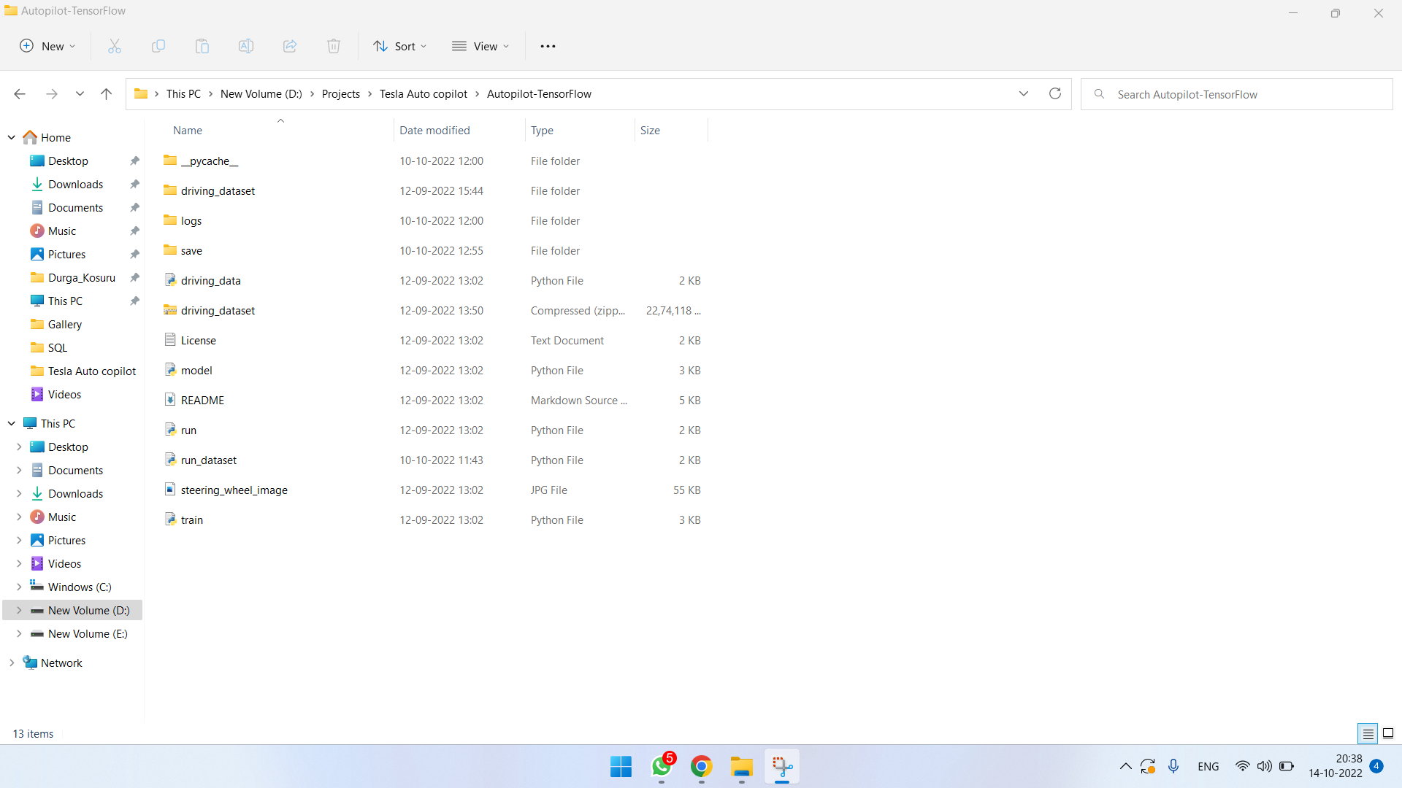

Slide 25
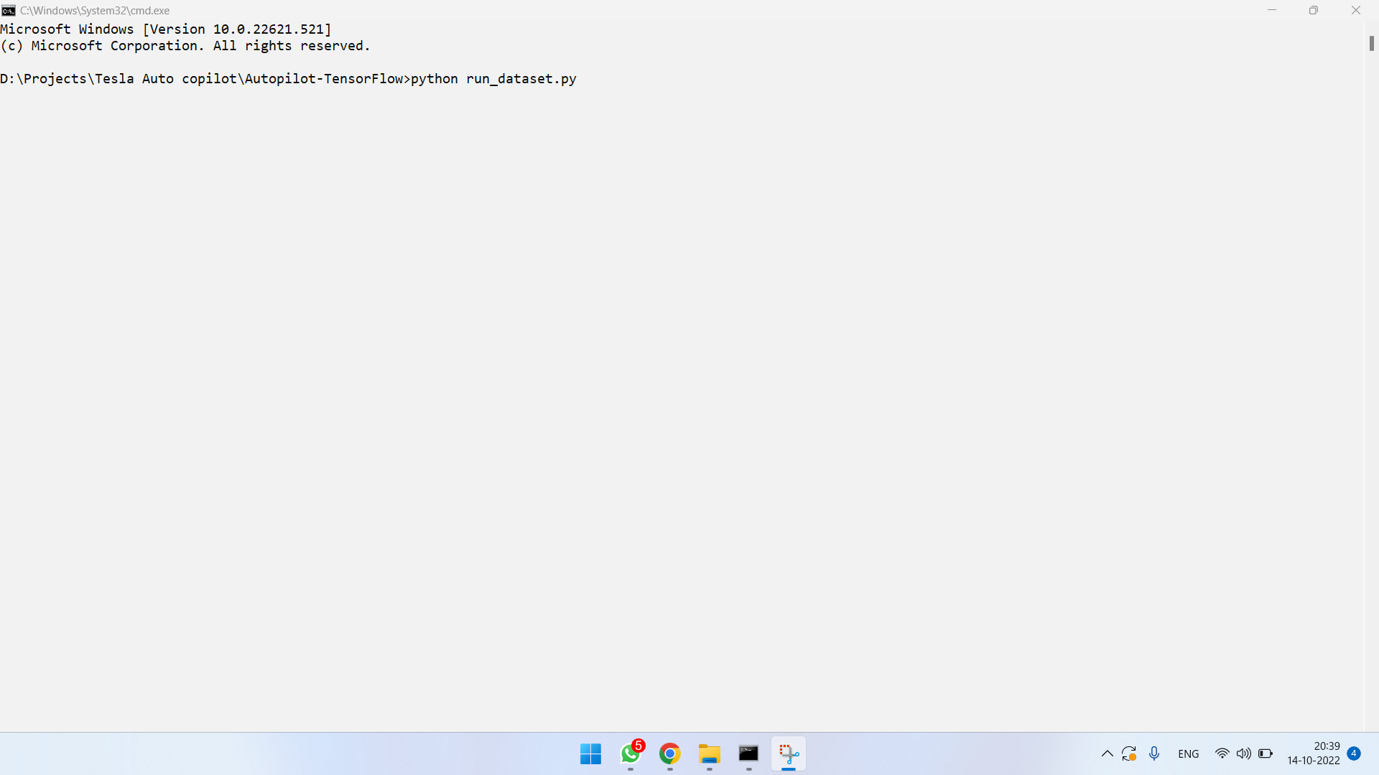

Slide 26
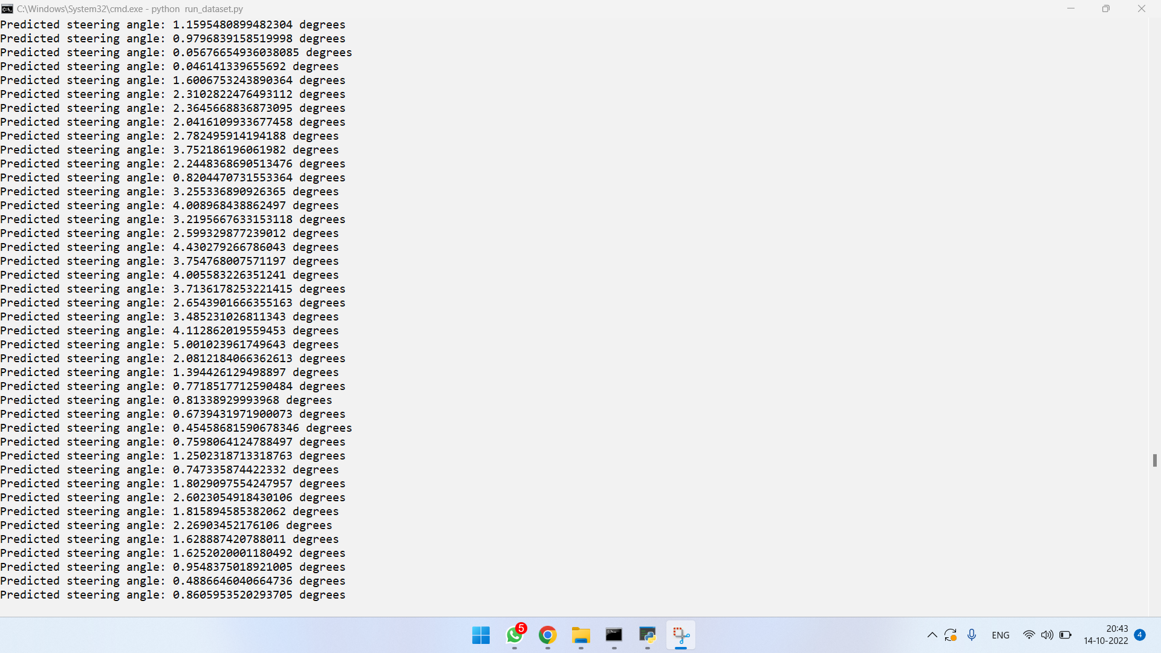

Slide 27
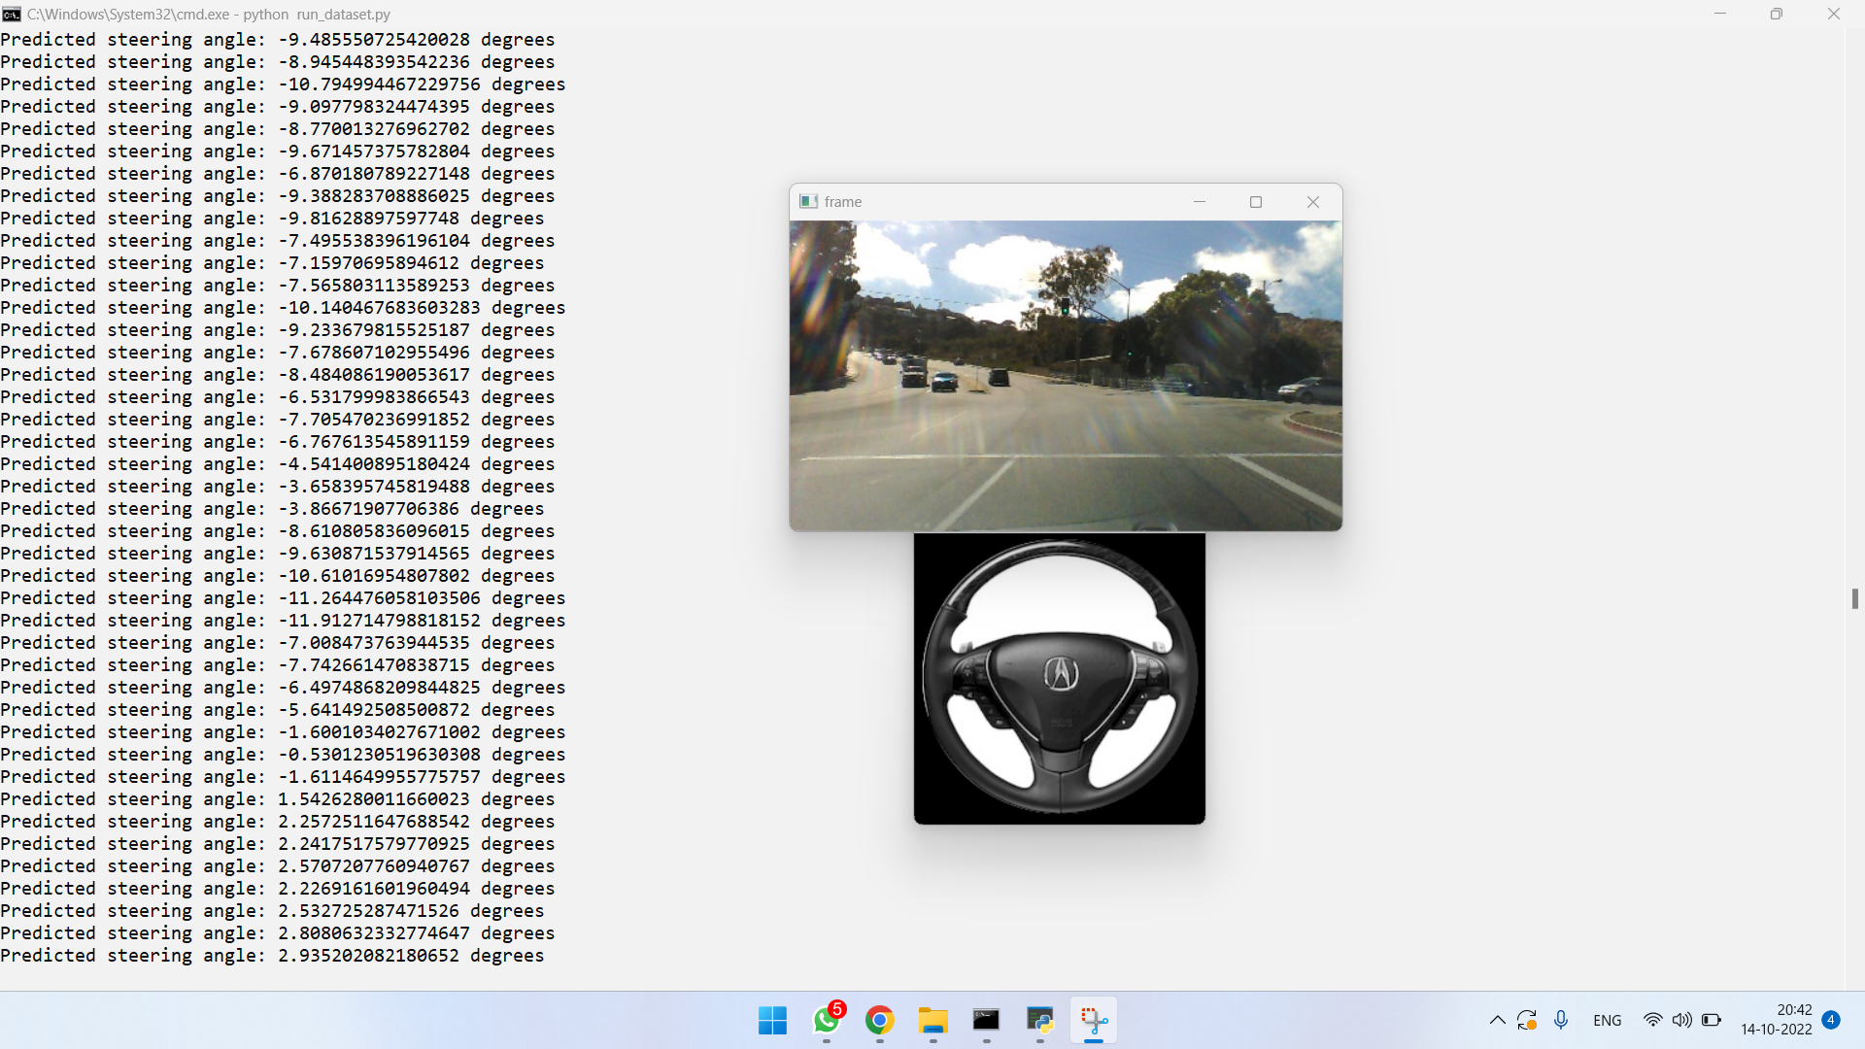

Slide 28
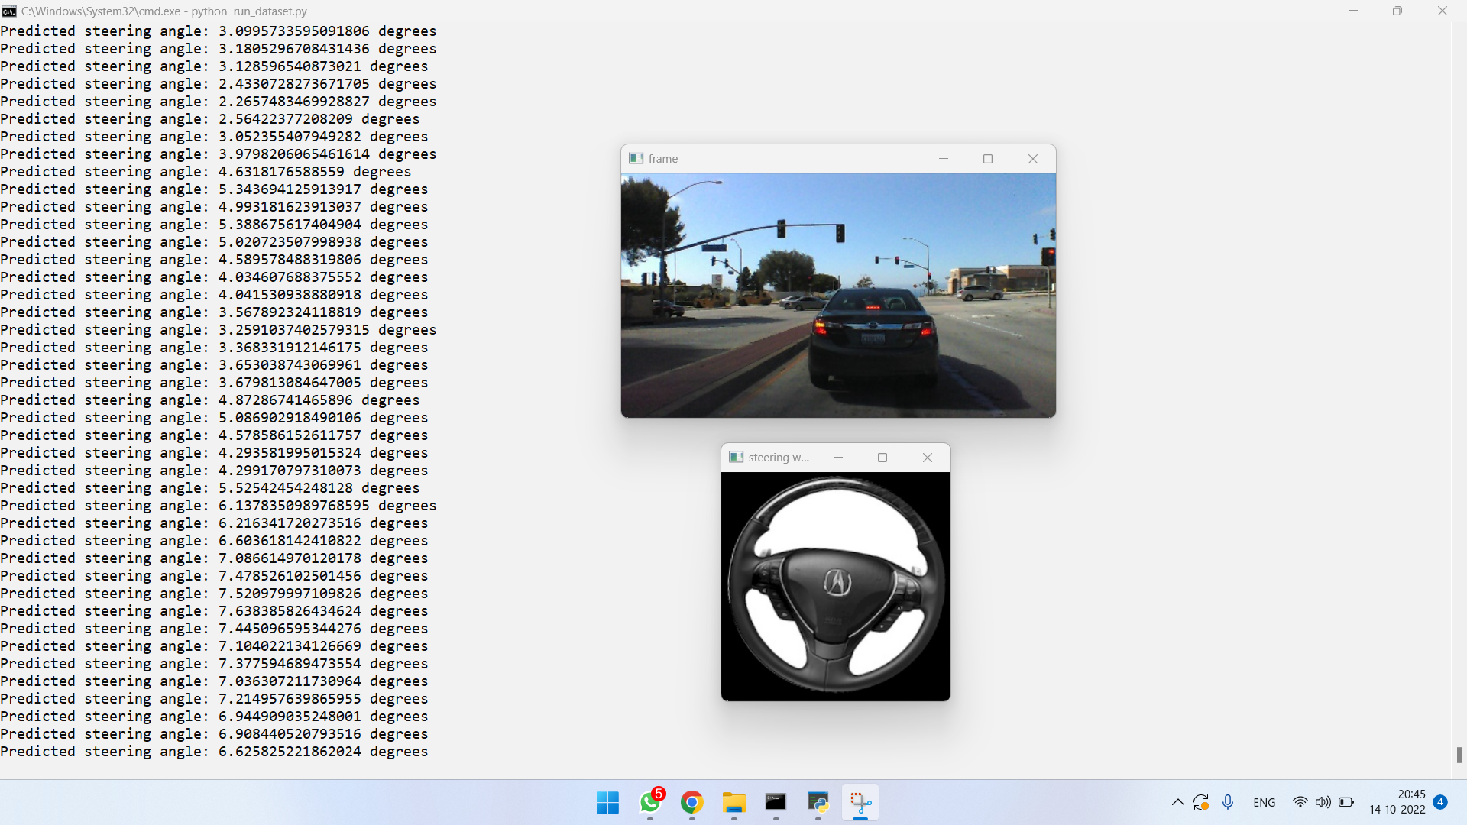

Slide 29
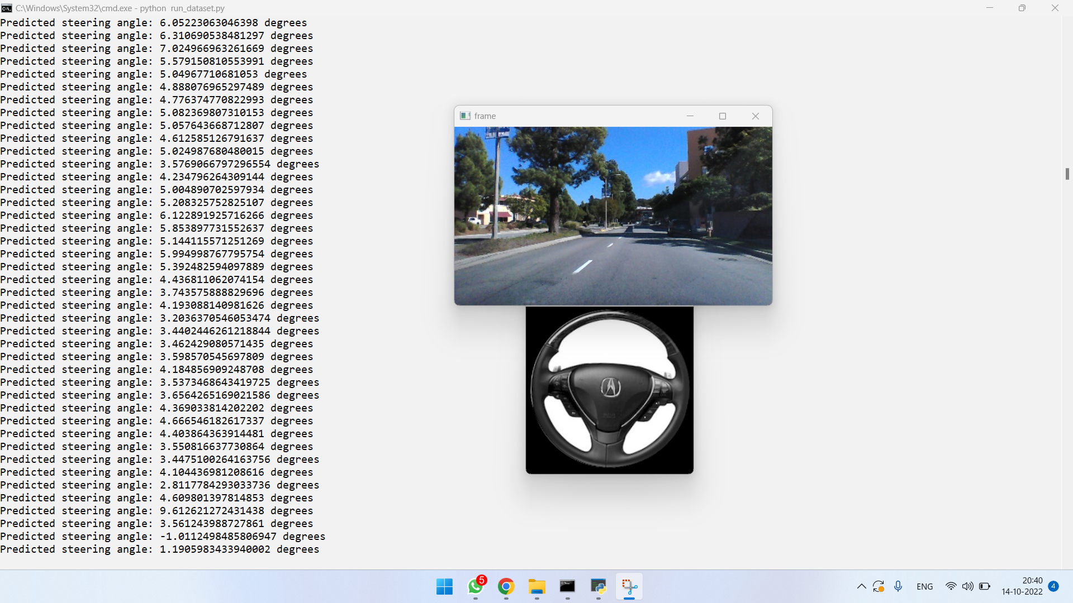

Slide 30


